Slide 1

Implement a search engine with domain-combination search function
Yang Bao
2020/04/08

Slide 2

What is domain-combination search? one example of single-domain search in a movie website
单击输入您的封面副标题
domain-combination search:
searching for related documents in multiple domains. For example, when we search a film with key words, all the domains should be considered including film name, description of the plot and the comments given by audience. Based on the searching results in multiple domains, the Top K related documents can be selected.

Slide 3
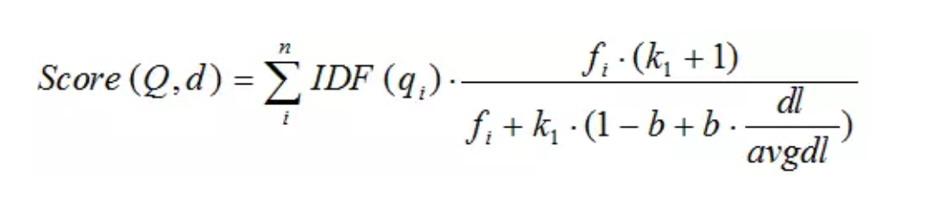
Implement single-domain search
1.construct the inverted index.
2. implement BM25 algorithm to get the basic score of each document.
3. rank all the documents and use min Heap to get the Top K documents.

Slide 4
Implement domain-combination search
Assumption 1 : the closer the length of query keywords is to the average length of movie names, the more likely the user is to query the film by its name.
Assumption 2: all the domains are independent.
Sf=k1*S1+K2*S2+K3*S3 , S1 is the score of searching in the name domain, S2 is the score of searcing in the comment score, S3 is the score searching in the summary domain.
Suppose that the average length of film names in the data set is l1, then the weight of S1 (k1) increases when the length of the query approaches l1. So I use the Gaussian function to simulate the process of changes in K1.
This is the gaussian function. σ is the standard deviation and μ is the mathematical expectation.

Slide 5
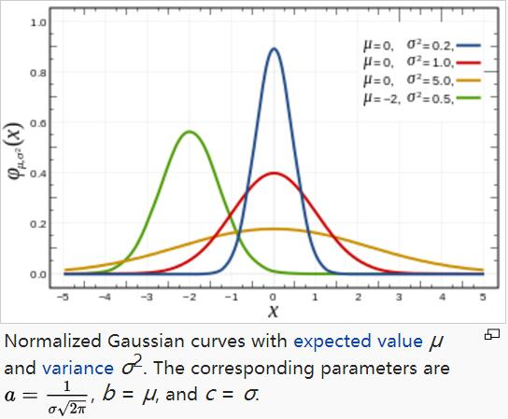
We let σ=1,μ=l1,l1 is the average length of all the film names. So when x=l1( x is the length of the query key words), the weight of S1( the score of searching in the name domain) reaches the highest. when x appraches both sides, the weight decreases.

Slide 6
Sf=g(x)*S1+(1-g(x))* ε1*S2+(1-g(x))* ε2*S3.
Now,we still need to do some improvement on Sf, because the value of S1,,S2 and S3 are not in the same range. So we need to do Normalization on the original Score.
So the value of Si,j is also in [0,1]. Also, we multiply the result by N to offset the effect of normalization on the result value, in which N is the number of films in the data set.
So we can get the calculation formula of the final score:
Sf=[ g(x)*S1/ +(1-g(x))* ε1*S2/ +(1-g(x))* ε2*S3/ ]*N.

Slide 7

Web UI with two main functionality:
1. Search in a single domain with conditions ( single-domain search)
2. Search in multiple domains with conditions (multiple-domain search)

